Slide 1
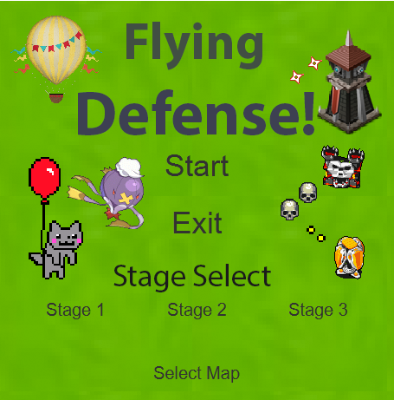
CSC 335 Dream Team
By Ethan Glasberg, Alex Gonzalez, Jarod Bristol, and Patick Darborn

Slide 2
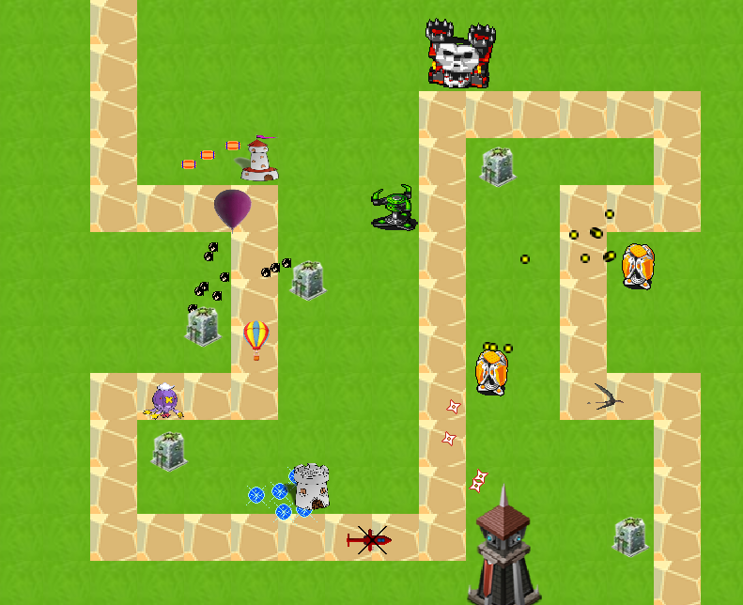
Product - Tower Defense Game
Flying Defence
Towers
8 unique towers with their own images
Each tower has own speed, radius, and projectile
Enemies
6 unique enemies with their own images
Each enemy has its own speed, cost, gold, and health
Maps
Tile based map
3 Supported maps,
Allows user to make own maps
Audio for each map

Slide 3



Design Layout - MVC
Model
Entity, GameState, Node, Player, Waves
Entity is was abstract class that has towers, projectiles, and enemies extending from Entity.
Node is used for the path
Player is the keeps track of HP and Gold.
Waves contains multiple waves of enemies
View
TDView, TDMainMenu, TDmicrotransaction, TDStageComplete
Graphics - JavaFX
Controller
TDController - Varies checks if GameOver, CanPlaceTower, and etc.
Resources
ResourceManager - Initializes all images and music tracks for all our assets

Slide 4
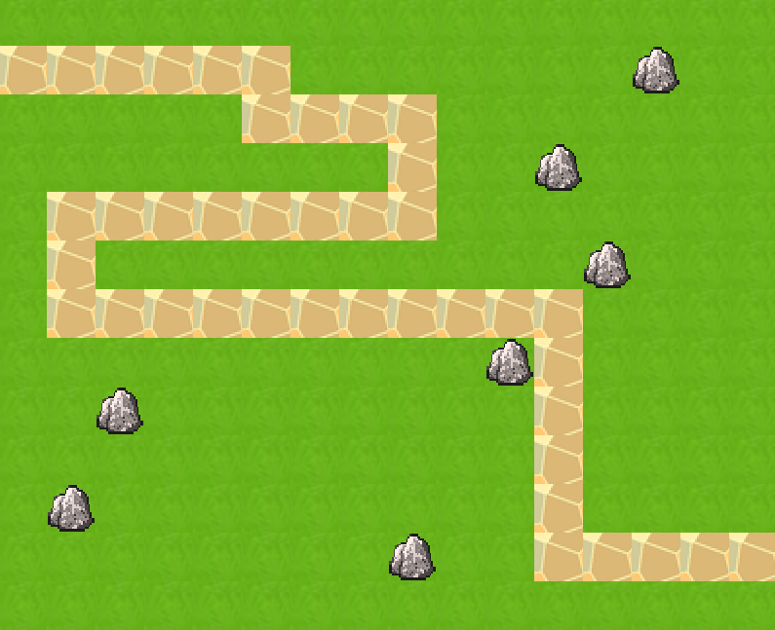
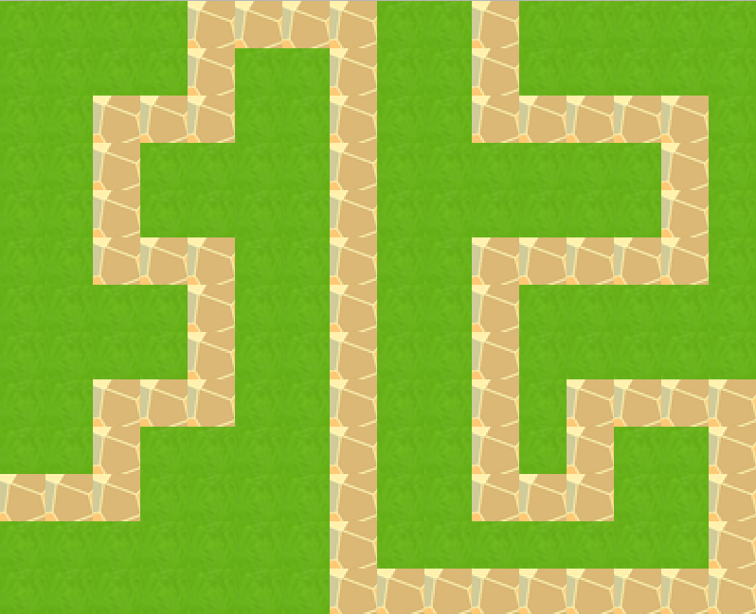
Wow Factor
Additional enemies
6 unique enemies with their own images and specifications
Additional stages
The user has 3 available maps to them, and the ability to make and play on their own map
Main Menu
Main menu with a background image depicting our game
Audio is playing at the main menu screen
Gives a selection of maps and an exit button

Slide 5




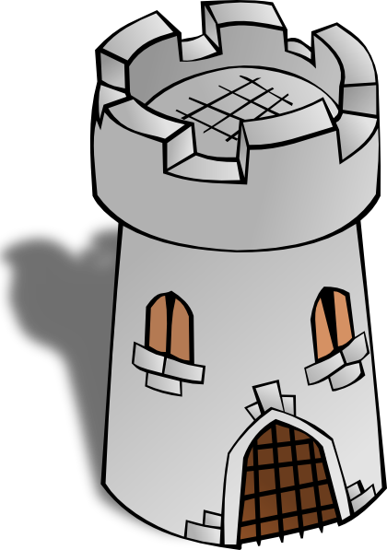



Towers
Base Tower:
Regular tower, nothing special.
Cheap Tower: You get what you paid for! (very low powered)
Expensive Tower:
High price tower for powerful projectiles.
Rapid Tower:
Fires at a high rate, but has weak projectiles.
MultiShot Tower:
A tall tower with moderate damage
Area Tower:
Has projectiles that cover a wide area.
One Shot Tower: One shots any enemy at a slow rate.
Thicc Yoshi: A jiggly ally that has armor piercing projectiles.

Slide 6

Enemies
Hot Air Balloon: Upgraded versions of the regular Balloon enemy. More health and slightly faster
Drifblim: The blimp Pokemon. A slow moving, but high HP enemy that hits like a truck. Gives out a large amount of gold.
Balloon: A regular balloon. The weakest enemy in the game.
Red Helicopter: A hard hitting helicopter that likes to come in high numbers.
Balloon Cat: A fast, but low health floating cat hanging from a balloon.
Pterosaur: A lightning fast dinosaur that is hard to track down.

Slide 7
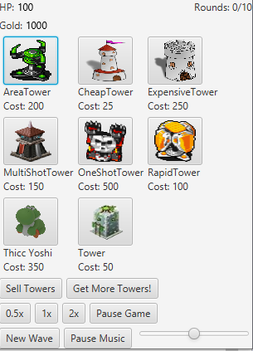
How to place/sell towers
Placing towers:
Click the button buy towers if sell tower button is on
Click on whichever tower you desire
Move mouse to whichever free space on the map
Can not place towers on roads
Can not place towers on dead zones
Click on free space with tower
Have fun!
Selling towers:
Click on sell towers button if buy towers button is on
Click on whichever tower you want to sell on the map
You get a 0.90 reimbursement of that tower

Slide 8
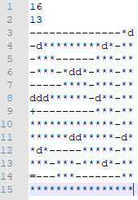
Making your own map!
mapsample.td
Step 1 - Size
Enter on lines 1 and 2 the columns
Columns, then
Rows
Step 2 - Characters
* is a free character, - path character, and d is a dead zone character.
Step 3 - Path
The map must contain a connected vertical/horizontal path.
The starting position must be a + sign to indicate where the enemies come from
The ending position must be a = sign to indicate where the enemies go off the map.
16
13
--------------*d
-d*********d*-**
-***------***-**
-***-*dd*-***-**
-----****-***-**
ddd******-d**-**
+---------***-**
*************-**
******dd*****-d*
*d*-----*****-**
***-***-***d*-**
=---***-------**
****************

Slide 9
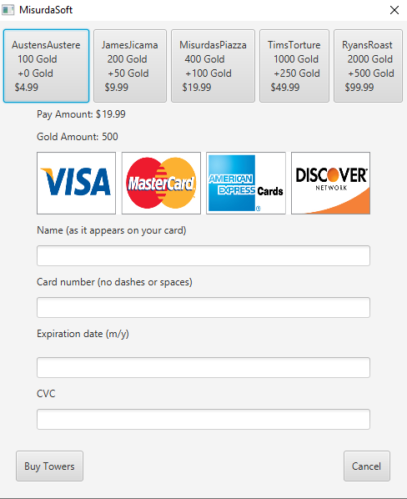
Need more towers?
Click on the ‘Get More Towers!’ button.
Select a package with how much gold you want.
Enter your credit card information in the fields below.
Click ‘Buy Towers’
Enjoy having more towers with your added gold!

Slide 10
Thank you!

